Slide 1
Technological Trends in Teaching and Learning
Ms. S. SARANYADEVI
M.Sc., M.A., M.Ed., SET & NET (Edn),PGDCA, PGDEL
Assistant Professor in Education
J. J. College of Education
Tiruchirappalli - 09

Slide 2
Content
Introduction
Evolution of Internet and Technology
Technology as Tools of Teaching
Emerging Technologies that Reshape Education
How mobile devices make learning easier for learners?
World’s Most used Social Platforms
Chat Applications
Online Content Activities
Educational Applications of Social Platforms
Summary
Suggested Readings

Slide 3
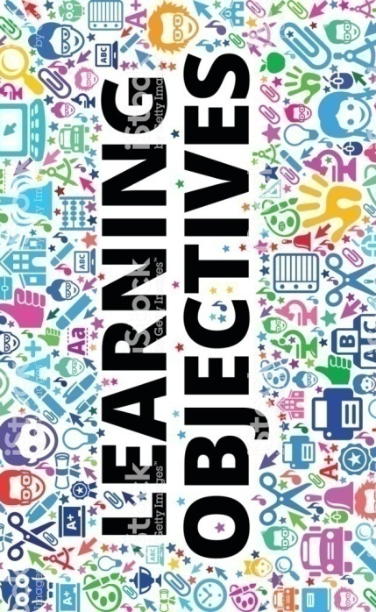
Learning Objectives
The PowerPoint presentation will help the learners to:
Recall and generate new ideas using technological tools.
Understand about emerging technologies which helps to reshape education.
Encourage and Utilize the mobile devices to enrich learning/ education.
Adapt mobile devices to make learning more interest.

Slide 4
Technology will not replace great teachers but technology in the hands of great teachers can be transformational.
- George Couros

Slide 5
Introduction
Information and Communication Technology (ICT) is an essential tool that can transform the present isolated, teacher-centered learning environment into a student-centered environment. ICT not only enhances student's learning experience but also helps them develop the skills needed to participate effectively in the technology era.
The impact that technology has on schools today is very substantial because it has the potential to change how people learn on education. Technology became more prevalent in the classroom through better learning, enhanced student participation and interactive programs. Technology now can be seen as an effective learning resource, as teachers want more technology in their classrooms.

Slide 6
Continue…
Today children watch their favourite cartoons on the same device and learn pictorial rhymes. They receive education through both flexible and non-intrusive formats. As a result, students across all age groups are discovering the joys of learning while at it, and having fun. There has been a notable change in the understanding of digital learning by parents and teachers too. Today , organizations are making efforts to turn the students ' attention back to reinventing the way they learn right throughout their lives.
The classrooms today are one of the few areas where the true effects of new technology can be witnessed. This includes interactive training, student privacy, paperless textbooks, digital learning, improved realism and better access to educational services, more innovative attitudes to the contact of interactive parent teachers.

Slide 7
Evolution of Internet and Technology
During this period,
First ever iPod launches.
MySpace becomes the most popular social media network and Face book college network is created.
During this period,
Snap chat gets launched.
The WIFI Kettle introduced and
The Apple watch goes on sale.
1991 - 1998
2005 - 2009
2017 - 2020
2001 - 2004
2011 - 2015
During this period,
Google home & 2nd-Gen Amazon Alexa Echo speaker are released.
Internet becomes humanized with highly responsive AI features, intutive search results etc. and the mobile networks are largely supported by renewable energy sources.
During this period,
The World Wide Web goes live with its first web page.
The first graphical browser is introduced and Napster is created.
During this period,
You Tube the video-sharing site goes live.
iPhone is launched, introduces the mobile web browsing and Google introduces the real time search feature.

Slide 8

Why do we need technology in classroom?
1
Exciting way to learn
Instant access to knowledge and Improve skills
2
3
Gives chance to collaborate
Reduce physical loads and improves self-confidence
4

Slide 9

How Can Technology Enhance Learning?
Through the increasing availability of student databases capable of monitoring individual development, teachers are empowered to define learning goals and distinguish curriculum based on their student's needs.
Whenever teachers try to present instruction using technology, they should do so using a channel relevant to the goals, learning style, mode and selected technology.
Teachers can design follow-up activities using technology to evaluate the learning of the students and the role that technology has played in that process.

Slide 10
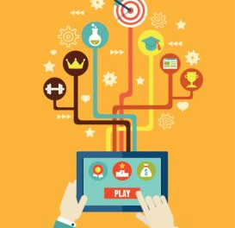


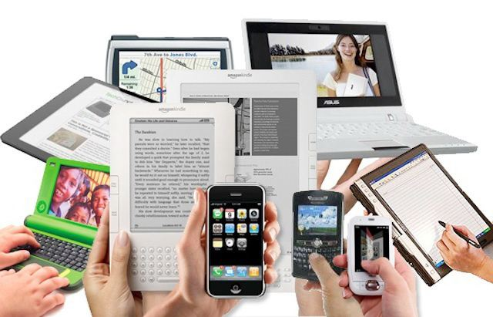
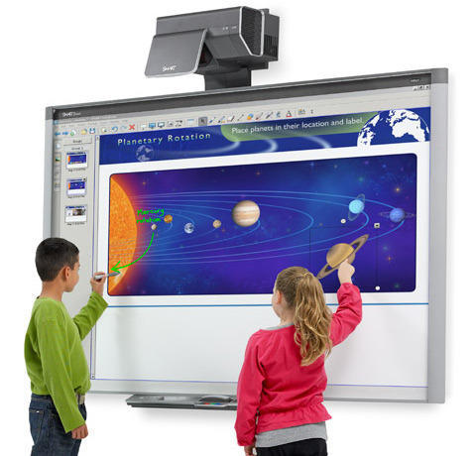
Technology as Tools of Teaching
Over the last few years the field of educational games has grown significantly. The digital games are given as educational resources and have many positive feedback including higher motivation for the students.
The Teacher will show a new lesson with a computer in the classroom, introduce new content, explain how to use new technologies and view new information on websites.
Mobile devices such as tablets or smart phones can be used to enhance classroom skills by offering professors the ability to get feedback.
Blogs allow for students to maintain a running dialogue, such as a journal, thoughts, ideas, and assignments that also provide for student comment and reflection.
An interactive whiteboard strengthen classroom experience by showing something that can be on a computer screen. It is interactive so that students on the interactive whiteboard can draw, write, or manipulate images.

Slide 11
Emerging Technologies That Reshape Education
Augmented Reality
It ensures students participation and engagement in classes, as they see and understand what they are learning. It allows students to see complex 3D objects physically, rather than imagining them.
Artificial Intelligence
It is a significant technology which helps education in a number of ways such as Personalized learning, Smart Classrooms, Monitoring the overall performance of classroom etc.
Gamification
Gamification adoption is perhaps one of the biggest educational technology phenomena that makes the learning experience even more fun and engaging.
Cloud Computing
It is essentially the group of computing resources that are located in different locations around the world. The system seems to be shared and can be accessed from anywhere in the world.
Virtual and Remote Laboratories
These are web applications which simulate real laboratory operations. Without the need for a physical device, virtual laboratories can be accessed anywhere and allows students to practice in a "secure" environment before using real, physical components.

Slide 12





People spend more time with devices
76%
Smart Phone or Mobile Phone
It provides – better means of communication, user learning options, great exposure to the latest stuff, ways to develop personality, simple ways of accessing applications.
45%
It helps us to function better and faster. Readers will learn about the many positive societal impacts of Laptop computers.
Laptop Computer
34%
Smart TV or Media Streaming Device
It is a perfect way to educate the people about the important issues that impact our daily lives in society.
32%
We are able to perform multitasking and multiprocessing
functions of data.
Desktop Computer
22%
Tablets are versatile and allow students and teachers to explore concepts in ways that the classroom never before had been able to.
Tablet Device

Slide 13





Technological Devices used in Classroom
i Pod
iPods can be used to practice skills such as reading or solving mathematics quizzes, decoding speech and etc.
STEAM Kits
Smart Board
It is a portable device to do hands-on experiments to promote creativity and to stimulate the whole process of thinking. It can be used in the classes of maths, physics, chemistry, technology, design, art, architecture and engineering.
Teachers use this to help the students interact by providing them with visual resources. It will attentively keep the students in the classroom. That can enable them to stay on track during discussions in the classroom.
Tablet
Laptop
Bring self-directed, collaborative learning to the students with portability.
Fostering online collaboration with other students , allowing students to obtain and view assignments online and submit their work via e-mail instead of being forced to print them and etc.

Slide 14

How mobile devices make learning easier for learners?

Slide 15
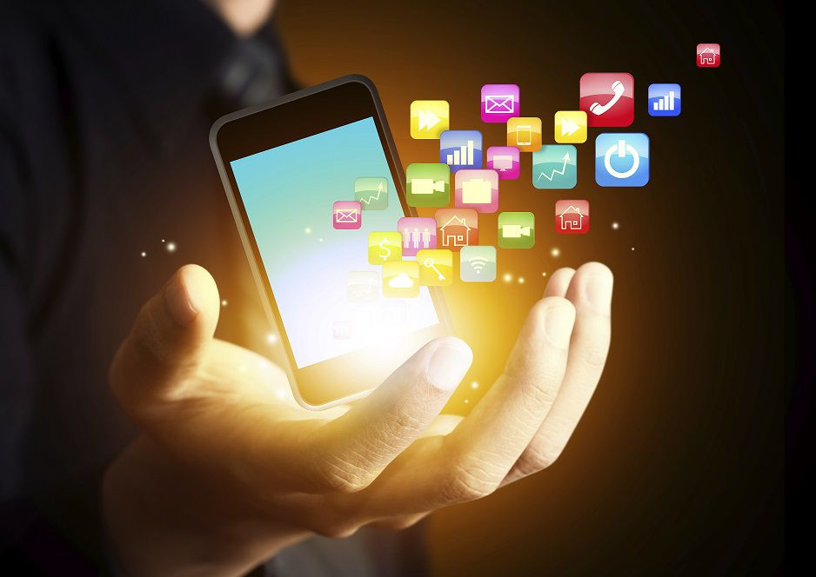
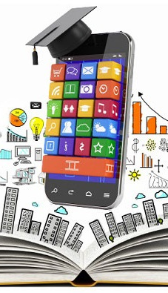



Smart Phones
Mobile Apps (Education)
Listen to Podcasts
Education apps have been provided to encourage students of all ages to learn and explore further in the field and create further excitement to make learning enjoyable.
Students can find podcasts on practically any subject/topic. Student can both enjoy listening to and learn from.
Record Lectures
Read Your Books
Student may record the lecture or discussion by having prior permission with the faculty/ expert.
Students can simply read e-books with you everywhere you go. With the Kindle or other eBook apps, student can catch up or get ahead on your reading for class or just read a book for fun.

Slide 16

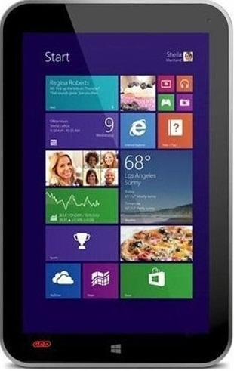

Tablet
Portability
Resources
Facile to carry, and durable. Students with weak or no internet at home can be given devices that have broadband connections.
Students will be able to access content through videos, interactive slide presentations, hyperlinked documents and more.
Authenticity and Autonomy
Maintain Control
It encourages flexibility for learners. Easy to use and allows us to step back and allow our students to work at their own pace, stand-by as a facilitator when students need help or push a little in the right direction.
There are lockdown software technologies that limit the use of a tablet to specific lesson plans and separate information online.

Slide 17






Laptop
Accessibility and Connectivity
Staying Connected
Allow students to access information and study whenever they have time to get an Internet connection wherever they may.
Laptops are a useful tool for connecting with students via email , instant messaging, or discussion forums.
Group Work
Writing and Revising
Laptops facilitate group work by allowing students to meet anywhere — whether it's a library, a school room or the home of a student.
Laptop allows students to compose texts such as essays, applications for jobs and scholarships, and cover letters in a more professional way.

Slide 18
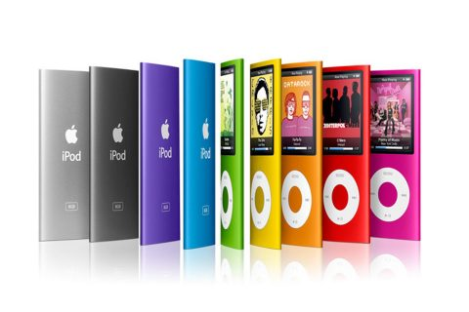
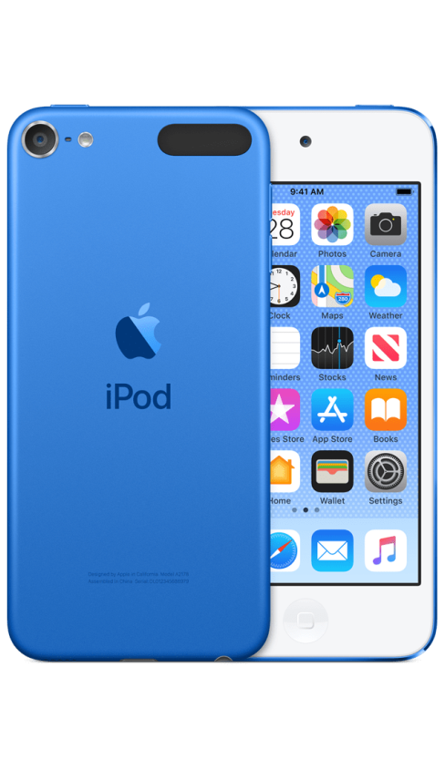
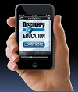
iPod
Ease of Use
Audio and Video Player
The touch screen interface of the iPod Touch is very user-friendly, and can quickly be learned by even the youngest students. It is intuitive, responsive, and highly motivating.
Deepen the knowledge of the content of the students by exposing them to high-quality visual and aural representations of locations, objects , events and concepts that they may not encounter otherwise.
Self-Expression and Creativity
Endless Apps
Students are actively engaged in authentic , real-world tasks about issues that interest them. Facilitate collaborative, small-group work so that each student can serve as a resource and amplifier for learning from their peers.
Anyone can simply impress your audience and add a unique zing and appeal to your Presentations. Easy to change colors, photos and Text.

Slide 19






World’s Most Used Social Platforms
Based on Active Users (in Millions). Source: KEPIOS Analysis, April 2020
2498
2000
2000
1300
1165
FACEBOOK
YOUTUBE
WHATSAPP
FACEBOOK MESSENGER
WECHAT

Slide 20
Chat Applications
It allows us to stay connected, from any part of the world, anytime.
There are various applications that provide chat services.
WhatsApp, Facebook messenger, yahoo IM, emails are among the most common.

Slide 21















Active users of Top Chat Applications (in Millions)
WHATSAPP
Teachers can create groups for audio lessons, assignments, and video content to be sent. Staying in touch with students outside the classroom helps.
1600
FB Messenger
A Facebook group can enable the students to set up discussion boards, communicate with each other and their teacher, and be connected to online projects & other classroom groups.
1300
We Chat
A virtual learning community to strengthen the writing skills of students while at the same time providing them, enhancing their vocabulary and grammar and providing more opportunities.
1112
QQ
The authors found out the role of the QQ community and the opinions and experiences of, some subject teachers, parents , and students through observations, interviews , and questionnaires.
823

Slide 22





Online Content Activities
Percentage of Internet users aged 16 to 64 who consume each kind of content
Via the internet each month.
Watch Online Videos
Watch VLOGs
90%
51%
70%
47%
Listen to music streaming services
Listen to online radio stations
41%
Listen to Podcasts
Source: We are social (Jan 2020)

Slide 23
Educational Applications of Social Platforms
Use a Facebook group to stream live lectures and host discussions.
Teacher can create discussions and twitter chats.
Use a Facebook page to broadcast updates and alerts.
Instagram allows students to practice digital storytelling.
Use Twitter as a class message board.
Syllabus, assignments, updates and resources can shared on Blogs.
Students use Pinterest for research will foster both digital literacy and modern research skills.
Students can easily search for ideas in their area and gain inspiration from Pinterest

Slide 24
Summary
Education is becoming hi-tech ever more. All the developments happening in the technology world have a strong effect on the education and learning systems.
To survive in today's tough competition, students need to understand the technology.
Today's technology helps teachers enhance their teaching beyond traditional text-based learning, and engages students with practical learning methods.
With easy internet access, smartphone use popularity, and social networking, the educational field has to seize opportunities in the form of e-learning for content delivery of educational material.
Collaborative learning, supporting students as creators, rethinking how schools operate, and redesigning learning spaces are some of the key trends in educational tech adoption.

Slide 25
Suggested Readings
Howard Pitler; Elizabeth R. Hubbell; Matt Kuhn (2012). Using Technology with Classroom Instruction That Works (2nd edition). ASCD.
W. Kenneth Richmond (2011). The Education Industry. Routledge.
Shirley Bach; Philip Haynes; Jennifer Lewis Smith (2007). Online Learning and Teaching in Higher Education. Open University Press.
David McConnell (2006). E-Learning Groups and Communities. Open University Press.
David H. Jonassen (2004). Handbook of Research on Educational Communications and Technology (2nd edition) Lawrence Erlbaum Associates.

Slide 26
Thank You

